Slide 1

School Data Analysis

Slide 2
Introduction
Project Goal –Understand and analyse the indicators for improving the quality of education in India
Focus – Retention of enrolled students in schools (Grade 1 to Higher Secondary) ,digitalization possibility
Analysis –School dropouts vs basic school facilities

Slide 3
Data at a glance
Data at a glance
Dropout Ratio | State & UT count | 36
 | Year | 2012 to 2015
 | Grades | Primary ,Upper Primary, Secondary and Higher Secondary(Boys and Girls)
Gross-Enrolment Ratio | State & UT count | 36
 | Year | 2013to 2016
 | Grades | Primary ,Upper Primary, Secondary and Higher Secondary(Boys and Girls)
Facilities
Schools Facilities - Computer, Electricity, Water, Toilet | State & UT count | 36
 | Year | 2013to 2016
 | School grade levels | Primary ,Upper Primary, Secondary and Higher Secondary

Slide 4
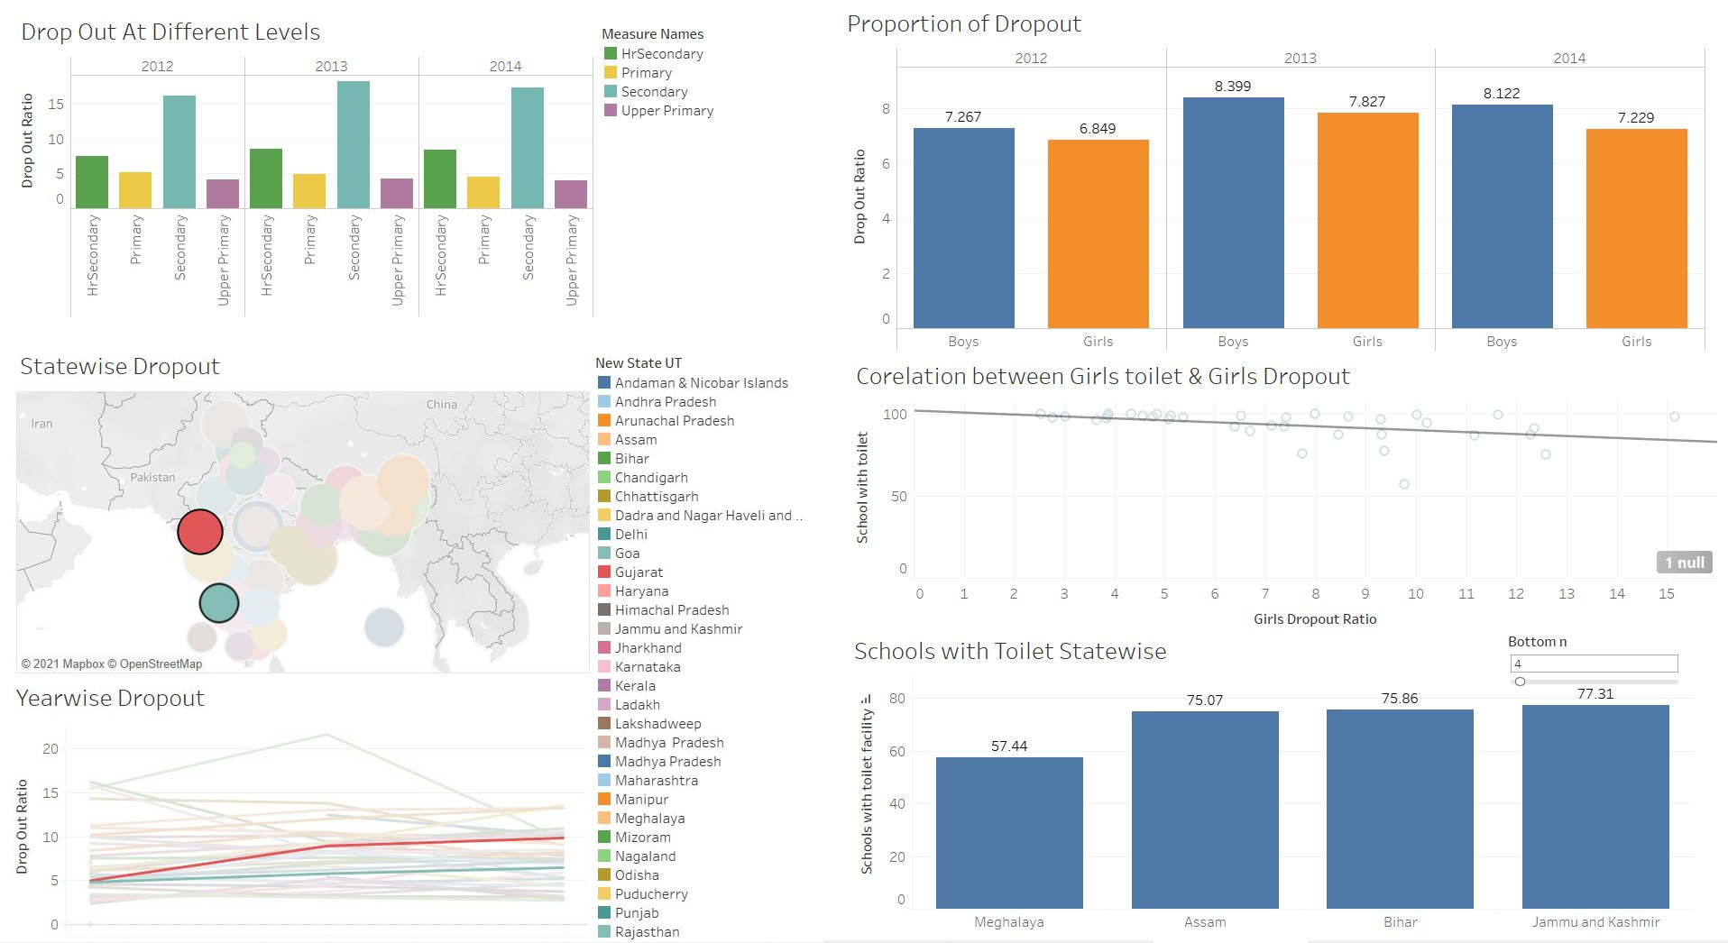
Drop Out Analysis

Slide 5
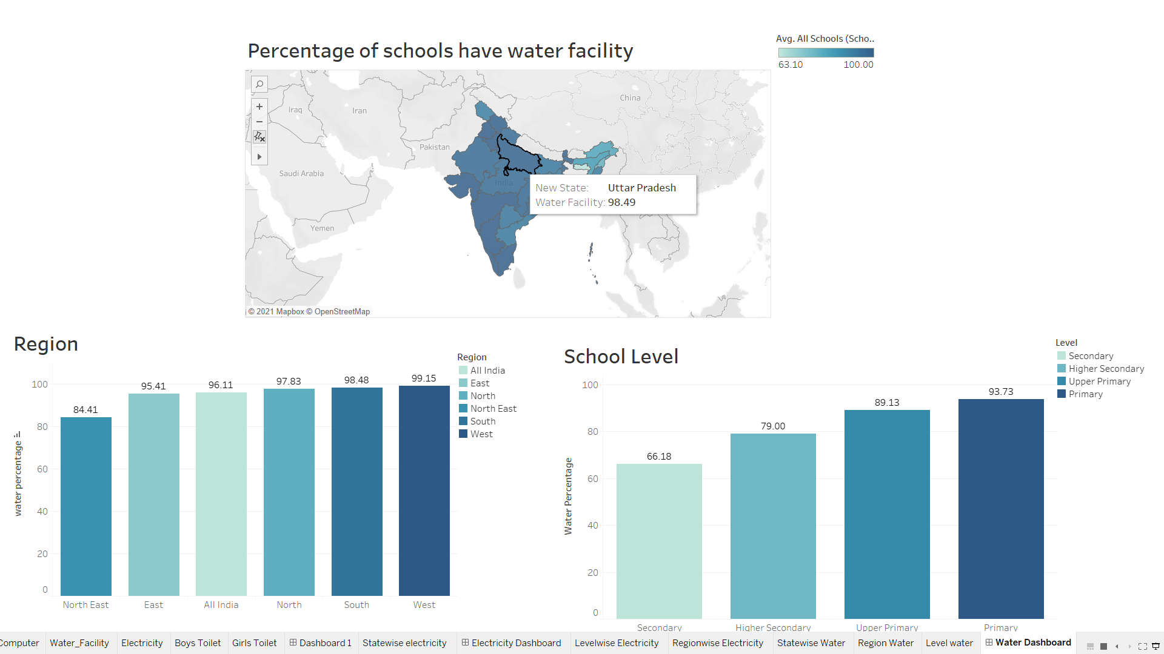
Water Facility Analysis

Slide 6
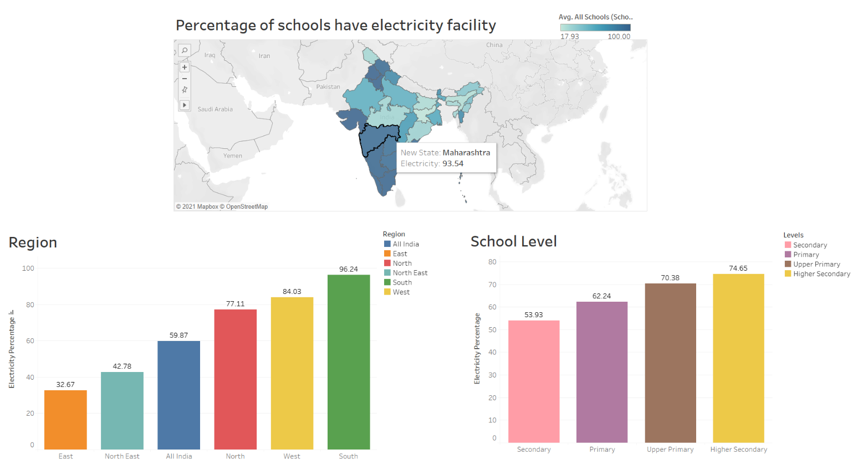
Electricity Facility Analysis

Slide 7
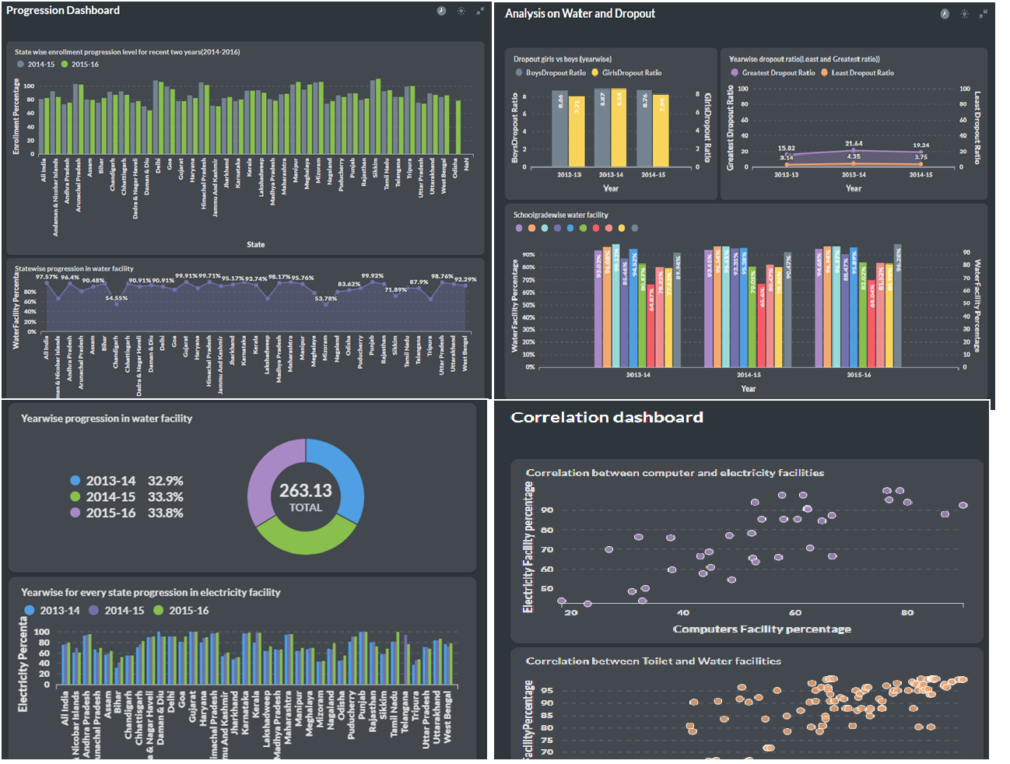

Slide 11
Region Wise Analysis To Achieve Digital India
Digital platform can change in education sector
Power of technology
Electricity facility and computer facility in all government schools in India

Slide 12
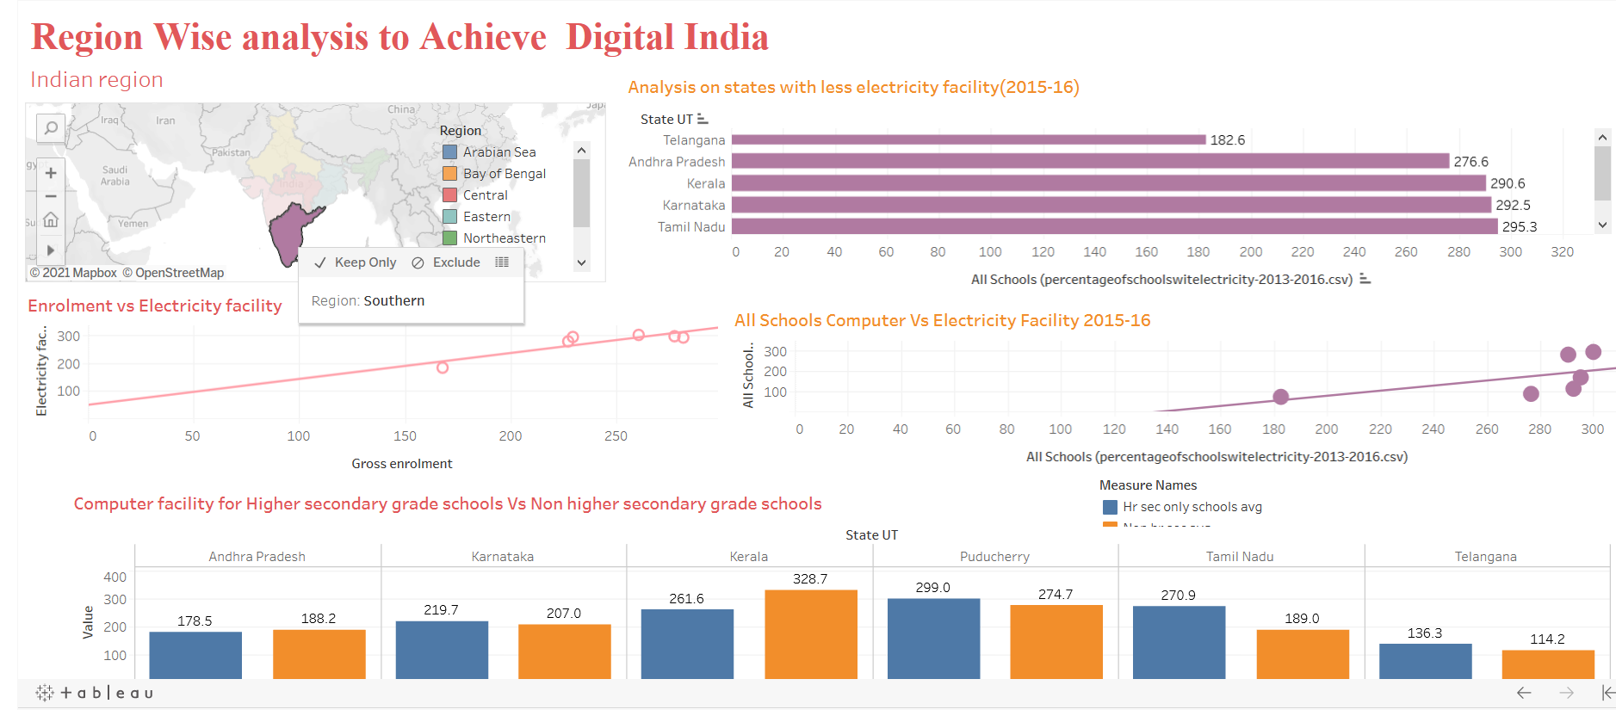

Slide 13
Gross Enrollment Analysis State wise
Grade wise Enrolment
State wise Enrolment
Enrolment vs toilet facility
Can toilet facility promote education?

Slide 14
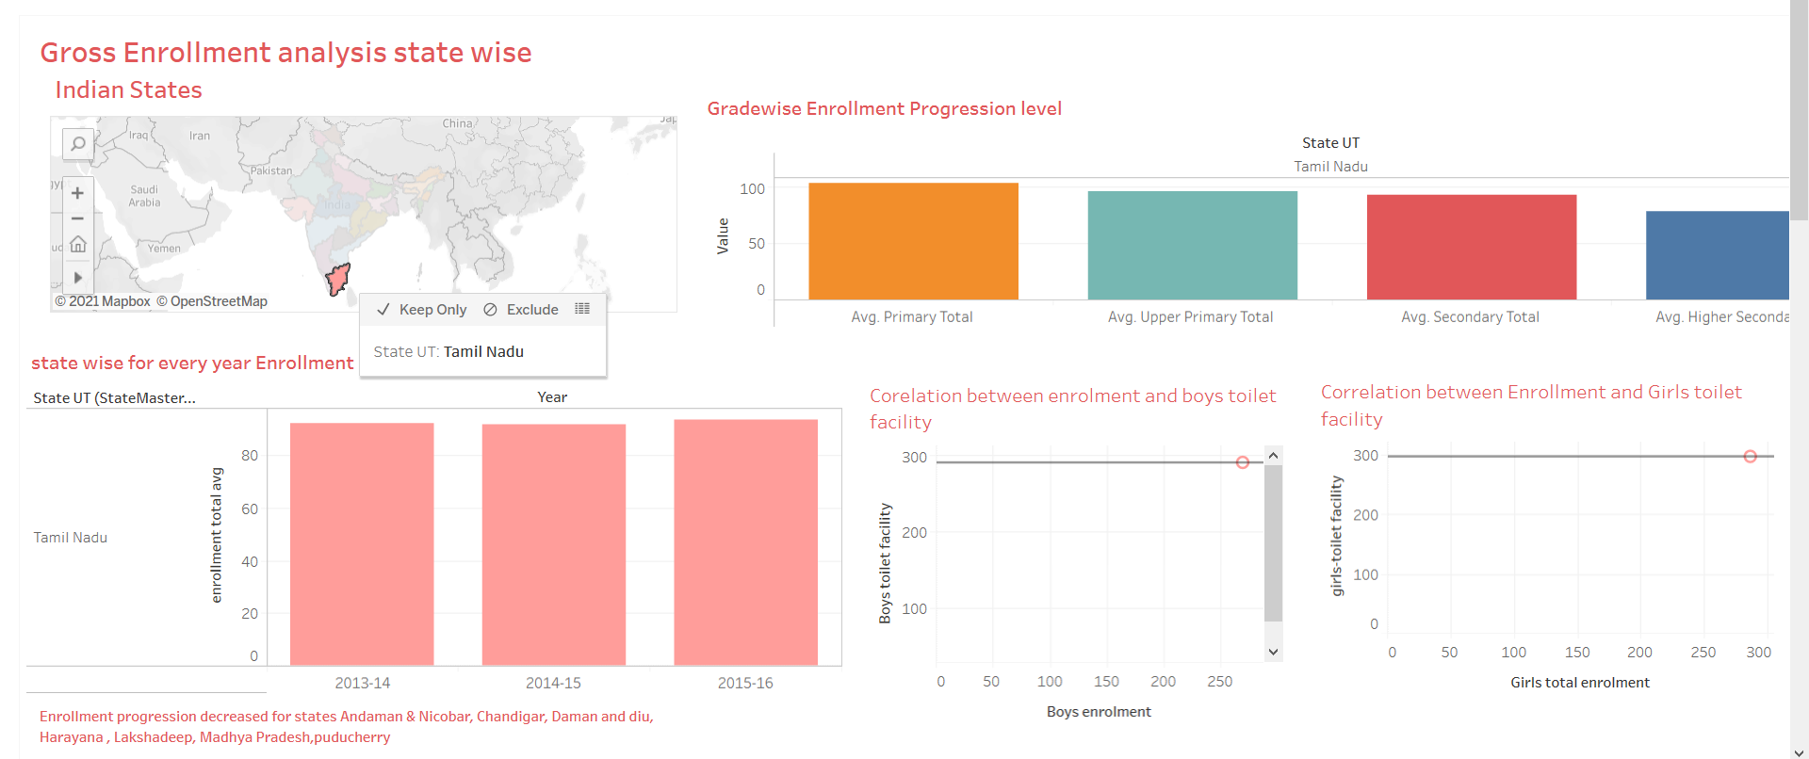

Slide 15
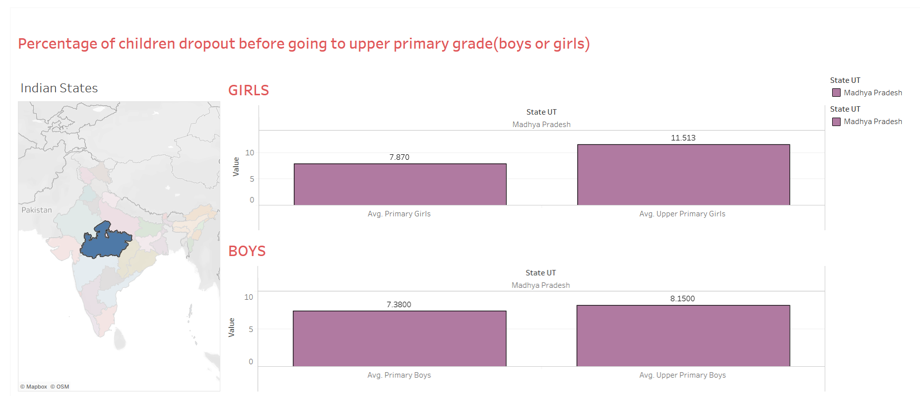
Percentage of children dropout before going to upper primary grade(boys or girls)

Slide 16
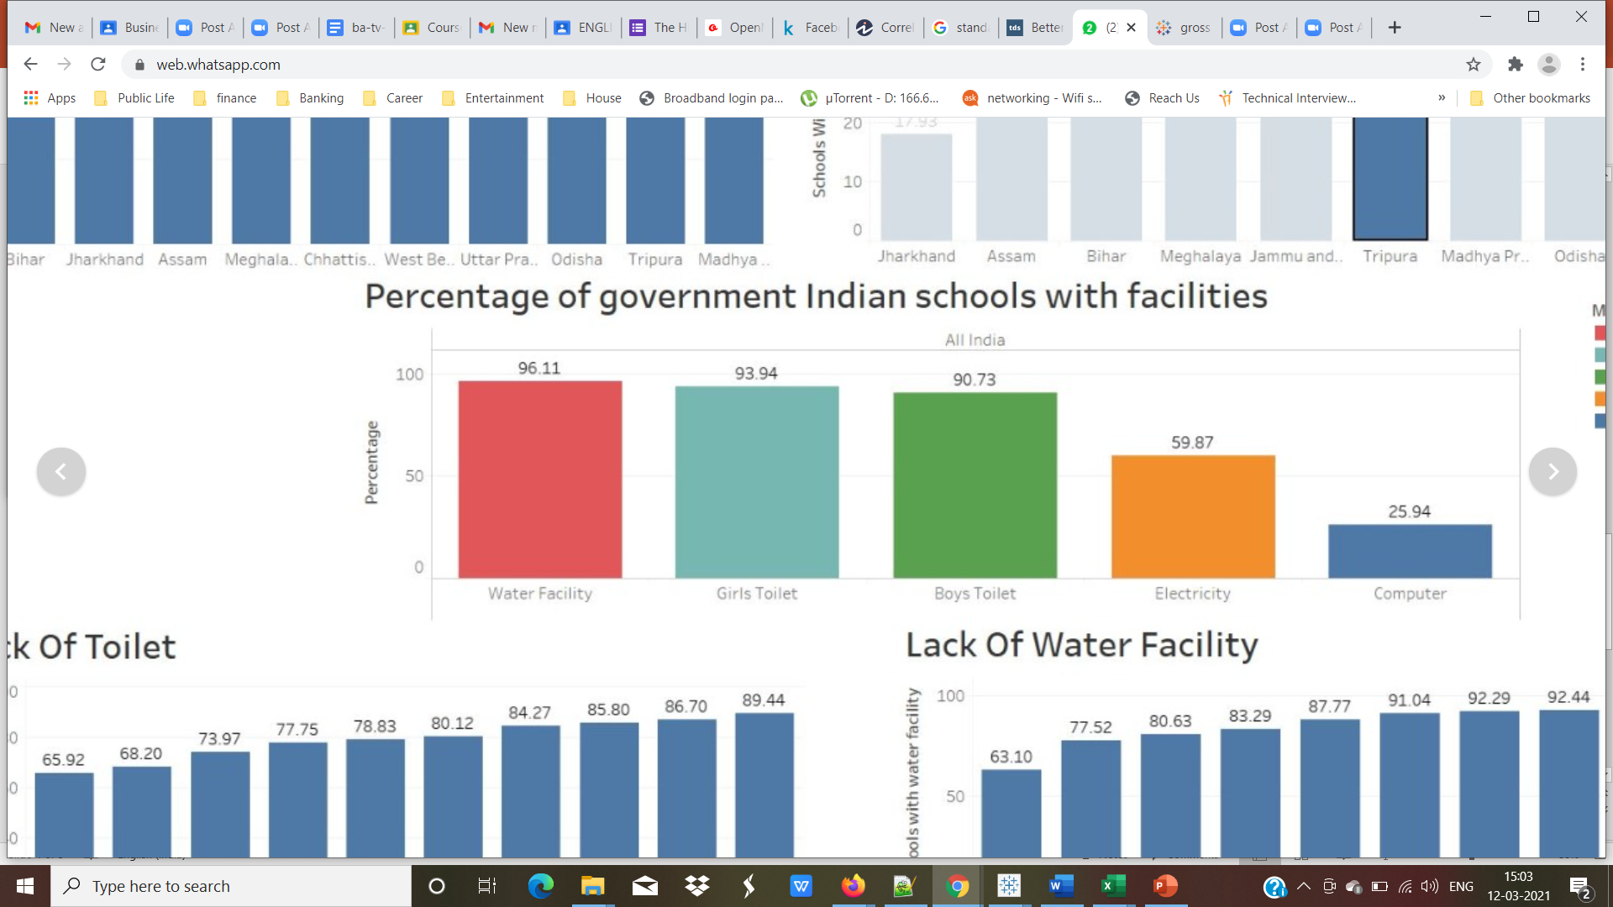
Conclusion overall Percentage of basic facilities in Indian government schools

Slide 17
Conclusion
Digitalization
Enrolment vs facilities
Dropout vs facilities

Slide 18

JAI HIND!!!
THANK YOU!!!

